Slide 1
DataSpark: Illuminating Insights for Global Electronics
By:
Yamini Devi

Slide 2
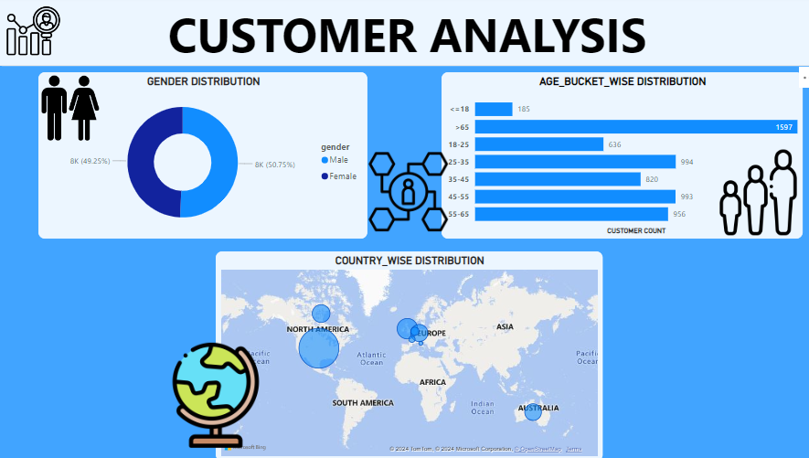
Customer Analysis
Gender Analysis:
Male customers significantly outnumber female customers. To balance this, targeted advertisements aimed at women could help increase overall sales.
Age Insights:
Customers are categorized by age. A bar chart reveals that individuals aged 65 and older represent the largest customer segment.

Slide 3
Customer Analysis
Gender Analysis:
The locations wise analysis was represented using the world map.
The size of the bubble says about the intensity of sales from that area.
The country wise analysis suggests that the North America is having Highest sales.

Slide 4
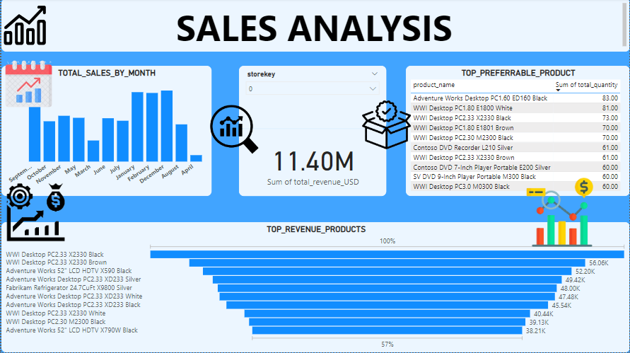
Sales Analysis
Monthly Sales Trends:
The peak sales months are January, February, and December, suggesting the need for inventory readiness. Sales are lowest in April and March, highlighting an opportunity to improve marketing and diversify product offerings.
Low-Performing Products:
The lowest-selling items are primarily from the home appliances and camera segments, suggesting a need for competitive analysis to identify gaps in these categories.

Slide 5
Sales Analysis
Top Products:
Computers rank as top sellers. Managing stock based on color preferences is crucial, as sales data shows good variation across colors.
Desktop and computer products dominate. Maintaining adequate inventory in this category is essential to meet demand.

Slide 6
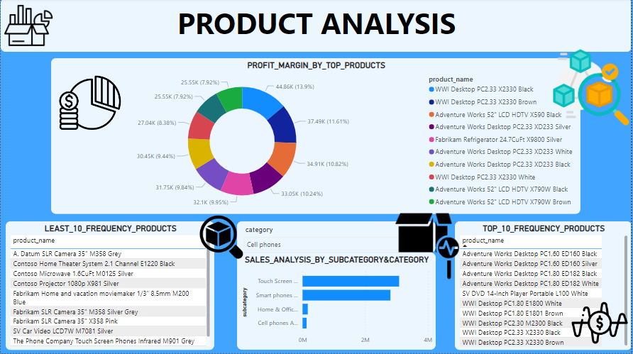
Product Analysis
Profit Margins:
A donut chart indicates that profit distribution among the top 10 products is even, reflecting positive performance.

Slide 7
Sales Analysis
Low-Performing Products:
The lowest-selling items are primarily from the home appliances and camera segments, suggesting a need for competitive analysis to identify gaps in these categories.
Top-Selling Products:
Desktop and computer products dominate. Maintaining adequate inventory in this category is essential to meet demand.

Slide 8
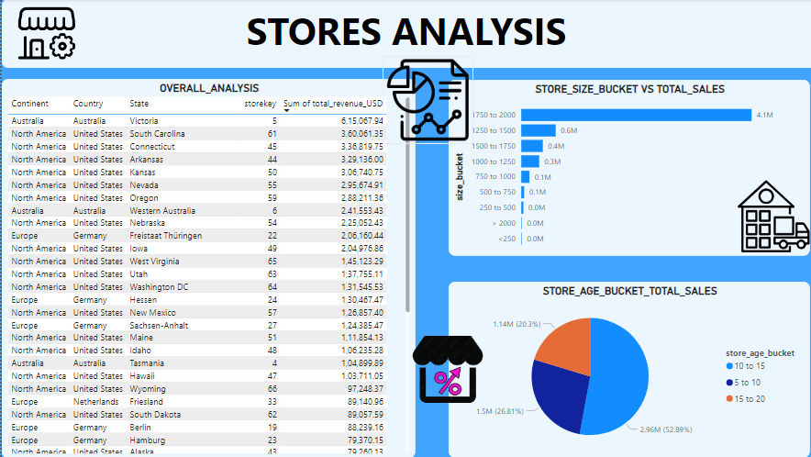
Store Analysis
Geographic Distribution:
North American stores generate the highest revenue. Expansion in Australia could provide growth opportunities, given the few stores there.

Slide 9
Store Analysis
.
Store Size Impact:
Stores between 1,750 and 2,000 square feet account for over 50% of total sales. Interestingly, larger stores do not necessarily correlate with higher sales.
Store Age Impact:
Stores that have been open for 10-15 years contribute the most to sales

Slide 10
Thank You

